Slide 1
Cloud Computing
UNIT IV

Slide 2
Cloud Deployment Models
The National Institute of Standards and Technology (NIST) defines four cloud deployment types:
Public cloud
Private cloud
Hybrid cloud
Community cloud

Slide 3
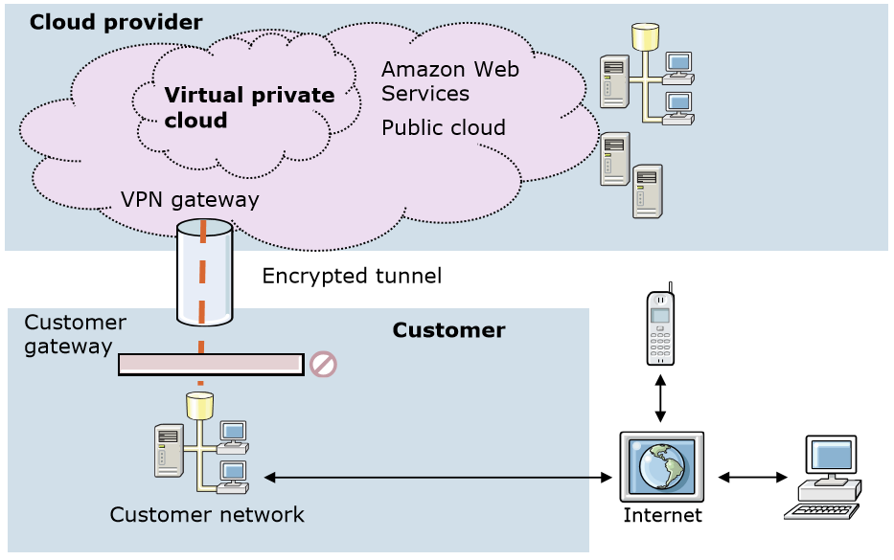
Virtual Private Cloud (VPC)

Slide 4
Virtual Private Cloud (VPC)
It is dedicated to a single user within a public cloud.
The virtual private cloud extends the customer network into the cloud provider’s space, making the additional resources available on demand.

Slide 5
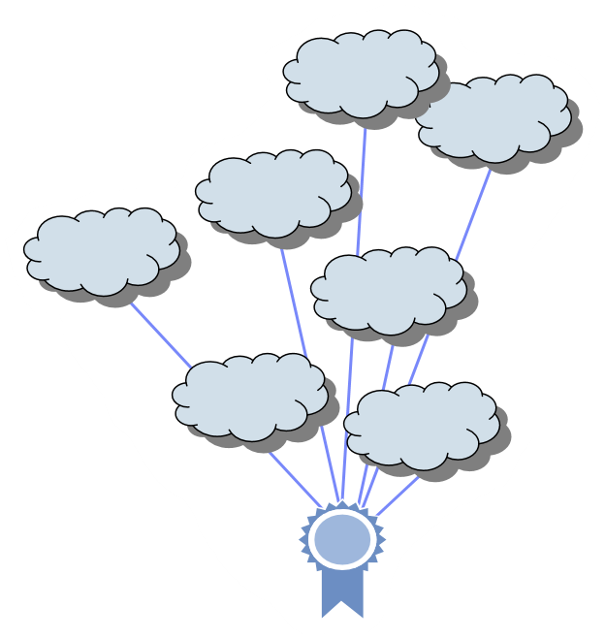
Vertical and Special Purpose Cloud
Vertical Cloud – Cloud for particular industries. It may contain information, applications, services for that industry.
Horizontal Cloud – Clouds for a purpose. Example – development, test, collaboration, budgeting.
Regional Cloud – It is localized. In accordance with government regulations.

Slide 6
Migration paths for cloud adoption
Use public clouds
Smaller organizations can use resources provided by larger cloud service providers.
Develop private clouds
Build your own private cloud.
Consider the metering of resources to determine the cost of doing business in cloud.
Build community clouds
Security issue more than private cloud but security threat is less than public cloud.
Organizations that share common goals.
Use hybrid clouds
Larger organizations use hybrid cloud infrastructure to balance workloads across internal and public clouds.

Slide 7
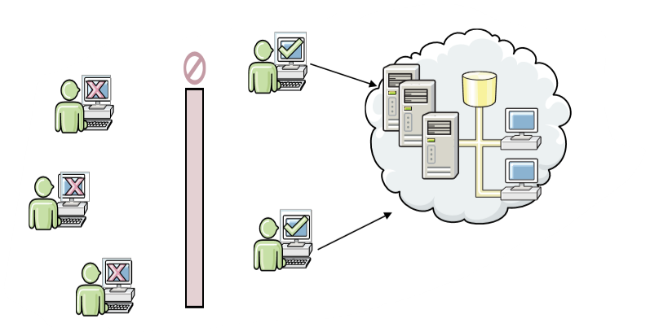
Selection criteria for cloud deployment types
Private clouds
Provides a dedicated and secure infrastructure.
Limited by the organization’s physical hardware and other resources.
During peak loads departmental resources can be used by other departments.
Can be run off premises by a third party infrastructure provider.

Slide 8
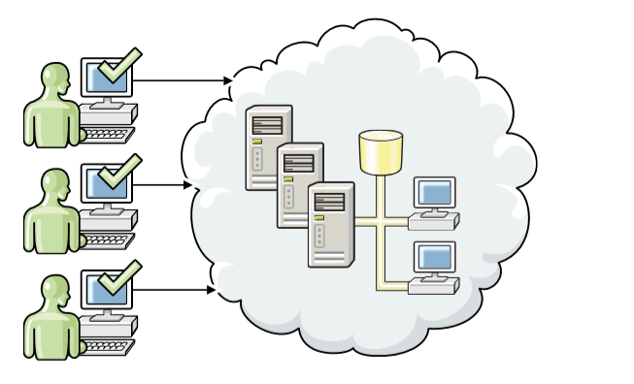
Selection criteria for cloud deployment types
Public clouds
Low cost data storage and disaster recovery solution but strong security controls are required.
Pay-per-usage basis.
Easy access to public domain applications and storage such as Google Apps, Google Docs and Gmail.

Slide 9
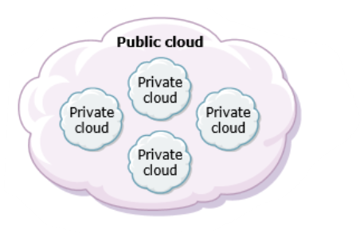
Selection criteria for cloud deployment types
Community clouds
Shared infrastructure by several organization that support a specific community.
Shared costs.
Shared policy and compliance.
Requires commitment from all parties

Slide 10
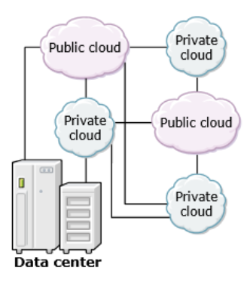
Selection criteria for cloud deployment types
Hybrid Clouds
Using services of vendors on private clouds costs money.
Consider moving some systems to an off-premises data center with applications offered back as a service.
Security concerns.

